Slide 1
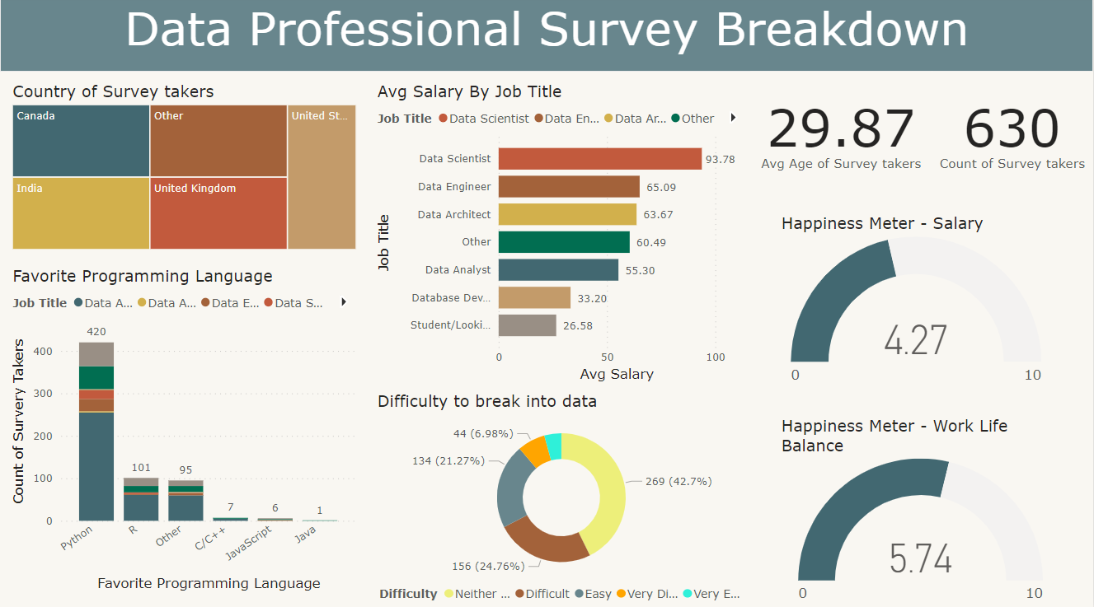
DATA PROFESSIONALS SURVEY DATA ANALYSIS
VISHAL MALAR

Slide 2


Slide 3
DATA PROFESSIONALS SURVEY DATA ANALYSIS
About Data
The data for this project comes from a survey of 630 data professionals in the USA, UK, Canada, India, and other countries, asking them about their satisfaction with various aspects of their jobs, as well as things like their age, gender, salary, nationality etc.
Key Features:
Average Salary by Job title
Favorite programming languages further
broken down by Job titles.
Level of difficulty in breaking into data
Happiness of participants using 3 KPI’s
Work Life balance
Salary

Slide 4
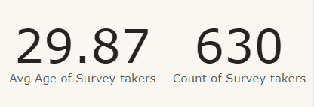
DATA PROFESSIONALS SURVEY DATA ANALYSIS
Total participants and average age:
There’s a total of 630 participants with an average age of 29.87

Slide 5
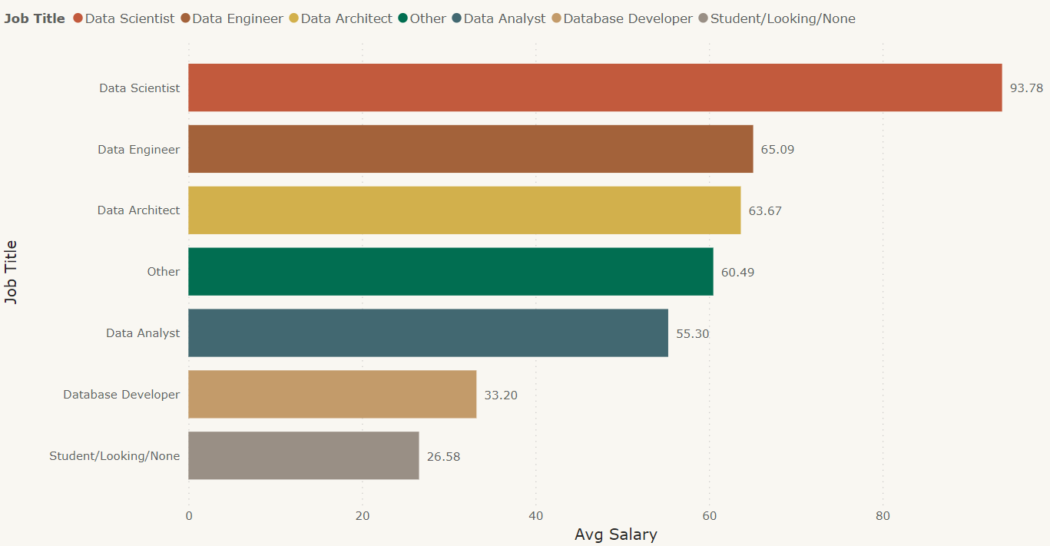
DATA PROFESSIONALS SURVEY DATA ANALYSIS
Average Salary by Job title:
As per the insights, Data Scientists are paid the most on average at almost $94k
Data Analysts earn around $55k on average.

Slide 6
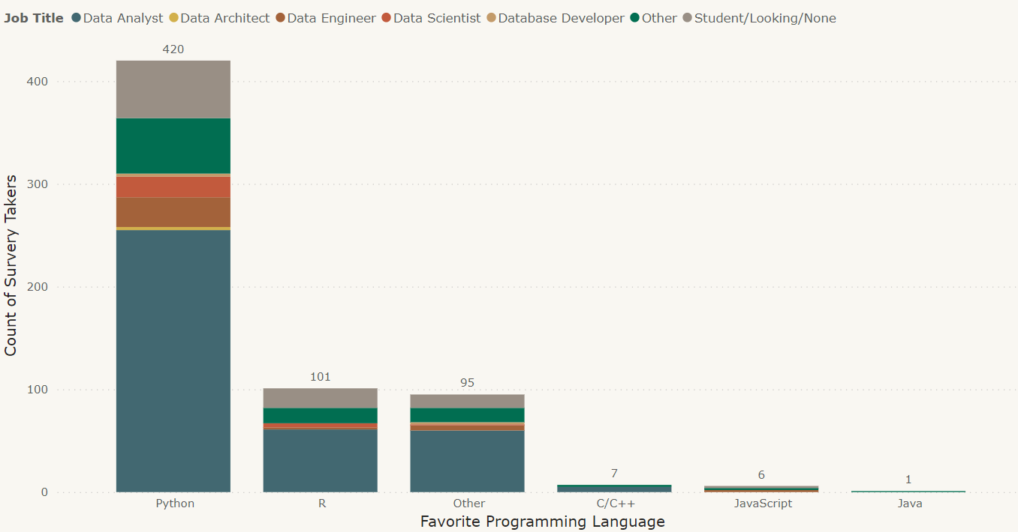
DATA PROFESSIONALS SURVEY DATA ANALYSIS
Favorite programming languages:
Python is the favorite programming language used amongst the participants and its most common among the Data Analyst job titles
67% (420 participants) chose Python as their most preferred language compared to R, Java script or any other languages

Slide 7
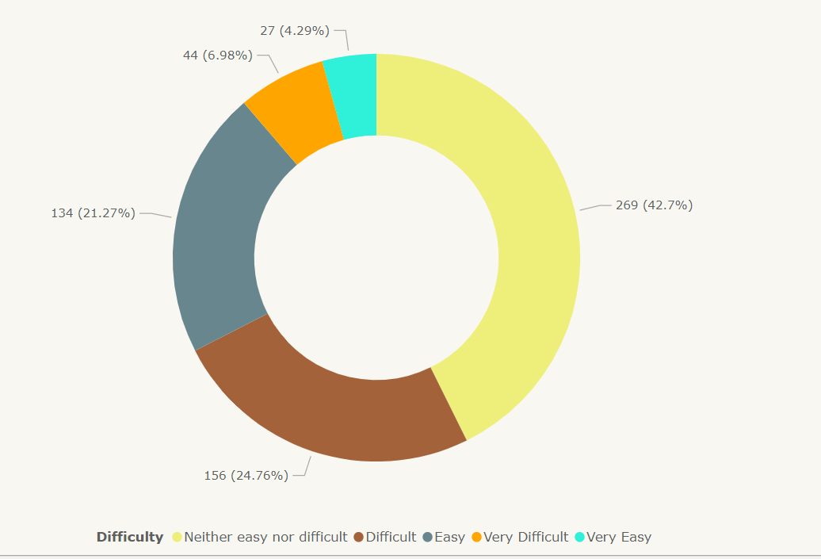
DATA PROFESSIONALS SURVEY DATA ANALYSIS
Level of Difficulty in breaking into Data:
On an average, 43% of data professionals found it neither easy nor difficult to break into the data space

Slide 8
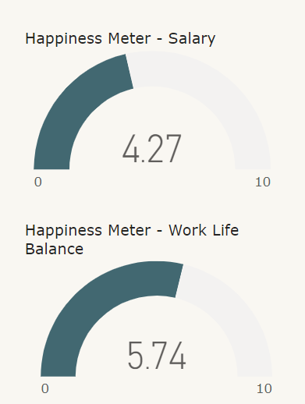
DATA PROFESSIONALS SURVEY DATA ANALYSIS
Happiness Meter:
On an average the happiness rating with respect to salary of all data professionals stood at around 4.3/10
This shows quite a number of people aren't happy with their salary and this could be attributed to a couple of reasons one of which could be the problem of being underpaid when compared to their workload.

Slide 9


